Slide 1
DATA MINING AND ANALYTICS
CUSTOMER CHURN ANALYSIS
ADITI MITTAL(RA1911003010226)
ANWEASHA SAHA (RA1911003010235)
R. VIJAY (RA1911003010239)

Slide 2
ABSTRACT
Customer Churn is one of the most important and challenging problems for businesses such as Credit Card companies, cable service providers etc.
Customer churn metrics can help businesses improve customer retention. We can classify customer churn (also known as customer attrition) by grouping them into different categories.
Contractual Churn, which is applicable to businesses such as cable companies and SAAS service providers, is when customers decide not to continue with their expired contracts.
Voluntary Churn, on the other hand, is when a customer decides to cancel their existing service, which can be applicable for companies such as prepaid cell phones and streaming subscription providers.

Slide 3
OBJECTIVE
All the SAAS companies nowadays should measure customer churn rate and need a solution to predict customers which are on verge of leaving the organization. This is where the machine learning algorithms comes into the act as the savior for SAAS organizations.
Machine learning can help predict customer churn. Customer churn is a critical metric because it is much less expensive to retain existing customers than it is to acquire new customers.
Earning business from new customers means working leads all the way through the sales funnel, utilizing your marketing and sales resources throughout the process. Customer retention, on the other hand, is generally more cost-effective as you’ve already earned the trust and loyalty of existing customers.

Slide 4
METHODOLOGY
Data Collection
Data Visualization and Exploratory Data Analysis
Data Processing
Model Creation
Model Evaluation
ALGORITHM/TECHNIQUE USED
Decision Tree Classifier: The goal of using a Decision Tree is to create a training model that can use to predict the class or value of the target variable by learning simple decision rules inferred from prior data(training data).
Random Forest Algorithm: Random forest, supervised learning algorithm is a flexible, easy to use machine learning algorithm that produces, even without hyper-parameter tuning, a great result most of the time.

Slide 5
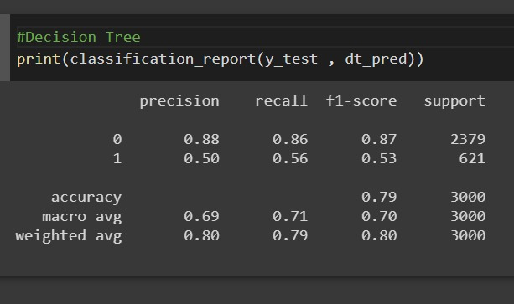
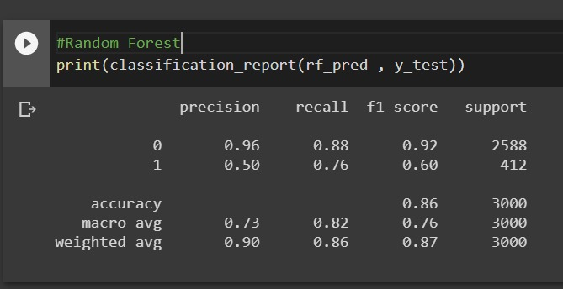
RESULT
Decision Tree Classifier Model
Random Forest Model

Slide 6
CONCLUSION
Based on the two predictive models we created, the one we created with Random Forest Classifier would be a better choice as it has better performance.
With the existing consumer insights through data, companies can predict customers’ possible needs and issues, define proper strategies and solutions against them, meet their expectations and retain their business.
Based on the predictive analysis and modelling, businesses can focus their attention with targeted approach by segmenting and offering them customized solutions.
Analysing how and when the churn is happening in customer’s lifecycle with the services will allow the company to come up with more preemptive measures.

Slide 7
THANK YOU

